Slide 1


Marin LAFCo Shared Services Workshop
Exploring the many ways shared services can be implemented, and how to successfully start them.

Slide 2
How to Participate
Use chat window for questions during each panel.
If you have technical difficulties send an email to “staff@marinlafco.org” and we can help you out.
We will take a break between panels to stretch & go to the restroom.

Slide 3
Welcome & Agenda
9:00 am | How To Participate - Olivia Gingold
9:10 am | Welcome and Introductions - Sashi McEntee
9:15 am | LAFCo 101 - Jason Fried
9:20 am | Panel 1: Exploring Successful Shared Services in Marin
10:05 am | 5-Minute Break
10:10 am | Panel 2: How to Implement a Shared Services Model
10:55 am | Q & A / Wrap-Up
11:30 am | Adjourn

Slide 4
Welcome!
Sashi McEntee, Commission Chairman
Jason Fried, Executive Director
Jeren Seibel, Deputy Executive Director
Olivia Gingold, Clerk/Jr. Analyst

Slide 5

Thank You To Our Partners

Slide 6
Why Consider Shared Services?
Share costs
Create job depth & specialization
Align operations
Identify issues
Develop relationships

Slide 7
How Can LAFCo Help?
Involve LAFCo early and often to save time and money in the future!
Strategic planning sessions
General plan meetings
Working groups

Slide 8
LAFCo is Neutral
LAFCo’s interest is:
Service sufficiency (current & future)
Financial stability
Compliance with state and local laws

Slide 9
LAFCo 101
LAFCo = Local Agency Formation Commission
Created by the State Legislature in 1963 and updated multiple times since
One LAFCo in each county
Decisions based on state law and guided by local conditions and circumstances
Oversees boundary changes and spheres of influence for cities and special districts
Perform Municipal Service Reviews, which, in part, look at opportunities for shared services to occur between agencies
Make sure the general public’s interests are considered

Slide 10
Panel 1: Exploring Successful Shared Services/Consolidation Models in Marin
The Ranch,
Yellow Bus JPA
Bob McCaskill, former Belvedere Councilmember
Central Marin Police Authority,
Central Marin Fire Department
Todd Cusimano, City Manager of Corte Madera
Marin General Services Authority (MGSA)
Michael Frank, Executive Officer

Slide 11
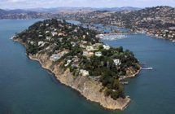
Belvedere-Tiburon Shared Services
Belvedere-Tiburon Joint Recreation JPA (“The Ranch”)
Created in 1975 at the behest of the Reed Union School District
Board: four members from each city plus one from school district
Provides all children & adult rec programs for the 2 municipalities.
Budget: approx. $2 million
The JPA is self-funded (with no operational funding from the 2 cities)
In 2013 the two cities did help with the construction of a new recreation building

Slide 12

Belvedere-Tiburon Shared Services
Tiburon Peninsula Traffic Relief JPA
Created in 2016 between Belvedere, Tiburon and RUSD
Board: two members from each city plus two from school district
Provides yellow school bus services to the three schools in the Reed Union School District and the Cove School in the Larkspur-Corte Madera School District
About 50% of the school district students ride the buses.
Budget: approx. $1 million
Primary funding is from the two cities and Corte Madera

Slide 13
Marin General Services Authority
Michael Frank, Executive Officer
Notes:
‹#›

Slide 14
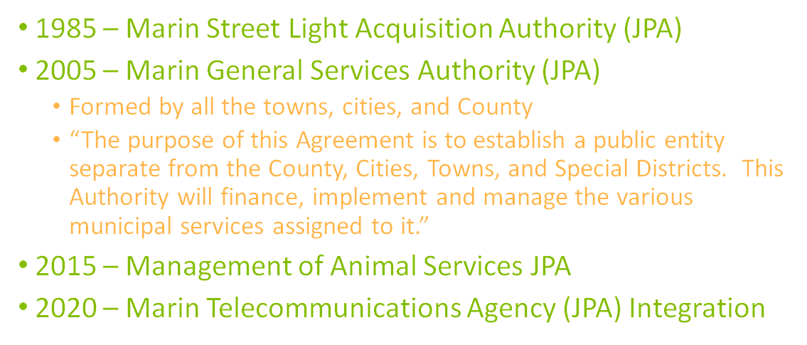
History
Notes:
It was originally formed in 1985 as the Marin Street Light Acquisition Authority ("MSLAJP A") to acquire streetlights from PG&E to save maintenance costs. ($500K annually)
The Joint Powers Authority Agreement creating MGSA states, "The purpose of this Agreement is to establish a public entity separate from the County, Cities, Towns, and Special Districts. This Authority will finance, implement and manage the various municipal services assigned to it."
MGSA offers various public services effectively and efficiently throughout the county in a uniform manner with minimal overhead expense.
‹#›

Slide 15
Mission Statement
The Marin General Services Authority provides the administration of a variety of programs and services where the policy issues are generally established, in arenas that are more cost effective to provide collectively or are significantly enhanced through partnering for the benefit of the greater Marin community.
Notes:
‹#›

Slide 16
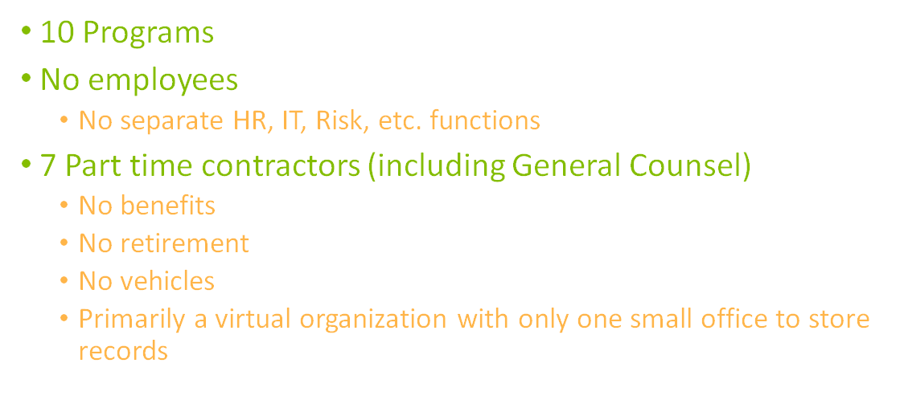
MGSA Basics

Slide 17
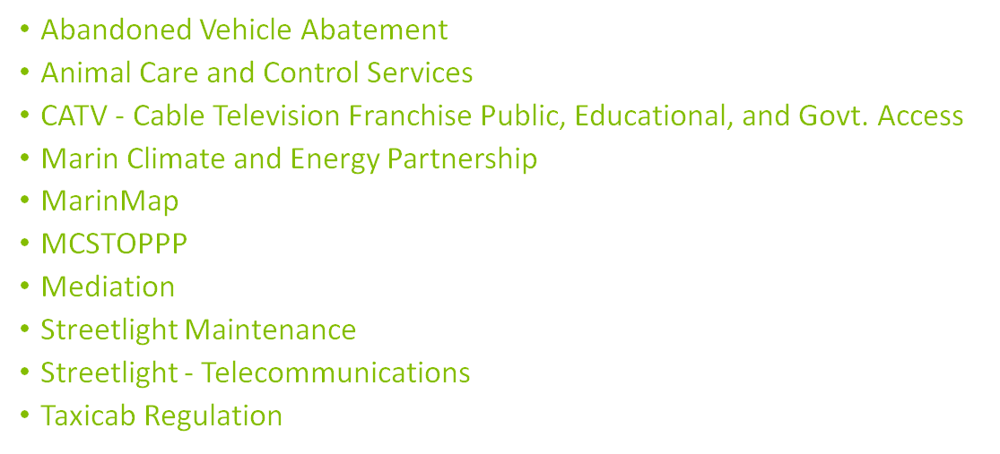
Programs
Program Information at maringeneralservicesauthority.com/programs/
Notes:
‹#›

Slide 18
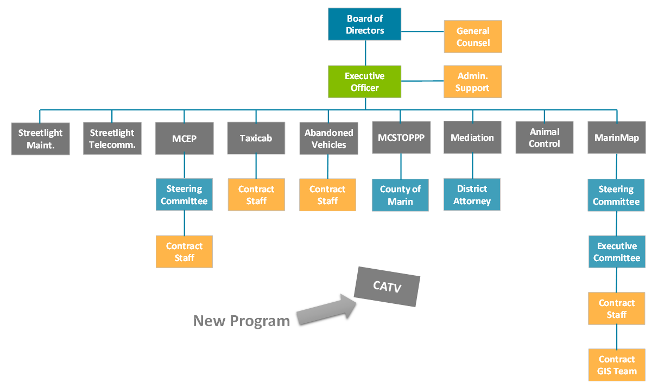

Notes:
Also mention major contracts
DC Electric
Marin Humane Society
‹#›

Slide 19
Panel 2: How to Implement a Shared Services Model
Southern Marin Fire Protection District
Cathryn Hilliard
Board President, SMFD
Murray Park Sewer Maintenance District
Betsy Swenerton, County of Marin
Former MPSMD staff
Central Marin Police Authority
Mike Norton, CMPA Chief
former president, Corte Madera Police Officers Association

Slide 20
Types of Shared Service Arrangements
Informal Agreement
Memorandum of Understanding (MOU)
Joint Powers Agreements (JPA)
Consolidation or Merger
Two or more agencies work together to get similar services at a better cost than if they would alone. Legal agreements tend not to be used.
MOUs occur when two or more agencies agree to work together on a given item or area of interest with a legal agreement in place. Each member of the MOU maintains its own independence.
JPAs are formal agreements between multiple agencies where, normally, each agency hands over control of a given item to the JPA to run on behalf of all member agencies. Normally each member agency appoints a member to the JPA Board.
When two or more agencies either form a new agency or move one agency into another agency.

Slide 21
Southern Marin Fire District’s Experience
HOW TO IMPLEMENT A SHARED SERVICES AGREEMENT
Look for the opportunity
Start the conversations early, even if you don’t implement the agreement for some time or ever
Create a Plan or Agreement through collaboration with the agencies involved. Must encompass perceived benefits to each party
Leadership by Elected Officials, Management Staff, Labor, and Community Leaders are essential.
Include LAFCo in early stages.

Slide 22
Southern Marin Fire District’s Experience
Clearly spell out:
WHAT:
What is being shared and how? The Vision
WHEN:
When does the Sharing of Services begin and end. When can the participating agencies and their constituents expect to see the matrices that will be used to evaluate the benefits and risks to each party. The Benefit
WHY:
Make clear to all elected officials, administrators, labor and the community what we hope to accomplish that will benefit all. The Support

Slide 23
Southern Marin Fire District’s Experience
HOW (must be clear):
How will the Shared Services continue, lead to a merger or an annexation ?
Spell out exactly what services will be provided by whom?
How will we pay for them?
How will we agree on the measurements for success?
How will we gain mutual trust ?
How will we gain taxpayers support if a merger or annexation takes place?
Southern Marin Fire Protection District includes the unincorporated areas of Mill Valley, Tiburon and the City of Sausalito. SMFD is currently in a Shared Services agreement with the City of Mill Valley. Marin LAFCo is a participant in the process.

Slide 24
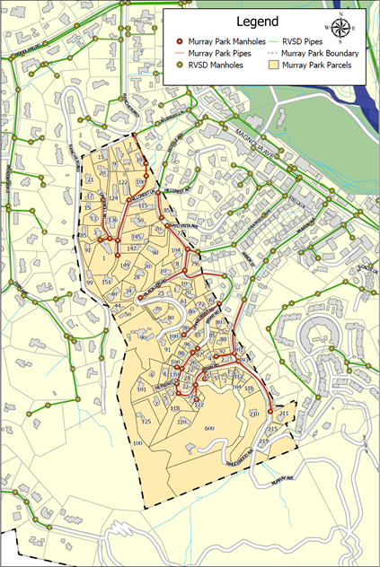
MPSMD Annexation into RVSD
Murray Park Sewer Maintenance District (MPSMD)
Established in 1949
5,500 LF of gravity sewer pipeline serving 91 living units
Maintained since 1993 by Ross Valley Sanitary District (RVSD)
Located entirely within RVSD’s boundary
Drains into RVSD’s system
Ross Valley Sanitary District (RVSD)
Established in 1889, changed its name in 2017
Serves over 47,000 customers, operating and maintaining 200 miles of pipe and 19 pump stations

Slide 25
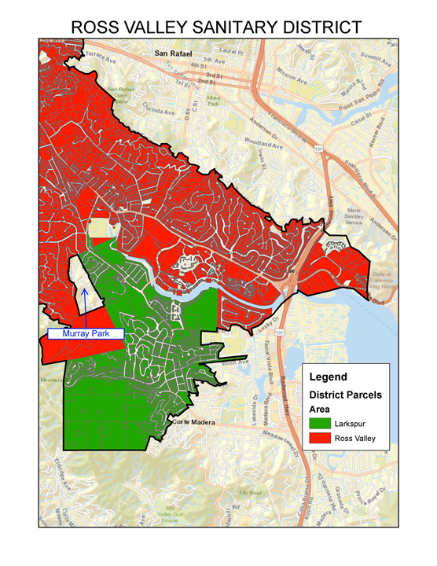
MPSMD Annexation into RVSD
The Case for Annexation of MPSMD
2017 LAFCo Wastewater Study
County of Marin - experts in local government
Ross Valley Sanitary District - experts in operating sewer systems
Creating efficiencies by combining the districts
Public Outreach & Outcomes
Positive feedback from Murray Park residents on the annexation
RVSD is a leader in customer service
Access to RVSD’s sewer lateral grant and loan programs
24/7 on-call service and proactive maintenance and capital improvements

Slide 26
Final Q & A For Our Panelists & Staff
Any further questions?

Slide 27
Lessons Learned
Shared services may not result in consolidation.
Aligning stakeholders - public, management, electeds, labor - is important.
Long road to consolidation - many years to develop relationships, resolve issues along the way.

Slide 28
Lessons Learned, cont.
It may take more than 1 attempt or approach - or it may not be possible at this time.
Official LAFCo process is the final step after all the work is done.
Including LAFCo early in the planning process can save time and money when you go for LAFCo approval.

Slide 29
Thank You For Attending!
Email us at staff@marinlafco.org to join our mailing list and participate in a short survey on today’s workshop.
We would really appreciate your feedback!
Contact:
Jason Fried
jfried@marinlafco.org
415-578-2304

